Slide 1

COMPUTER NETWORKS
(BCSC 0008)
TELNET
Copyright content, use only with the written permission of presenter mentioned

Slide 2
Text and Reference Books
Text Books:
Fourouzan B. A. (2004), “Data Communication and Networking”, 4th Edition, McGraw-Hill.
References:
Kurose, J. F. and Ross K. W. (2005), “Computer Networking: A Top-Down Approach Featuring the Internet”, 3rd Edition, Addison-Wesley.
A. S. Tanenbaum (2006), “Computer Networks”, 2nd Edition, Prentice Hall India.

Slide 3
TELNET
TELNET enables the establishment of a connection to a remote system in such a way that the local terminal appears to be a terminal at the remote system.
The topics discussed in this section include:
Time-Sharing Environment
Login

Slide 4
TELNET is a general-purpose
client-server application program.

Slide 5
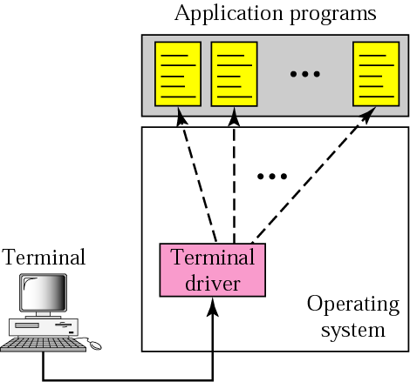
Figure 18.1 Local login

Slide 6
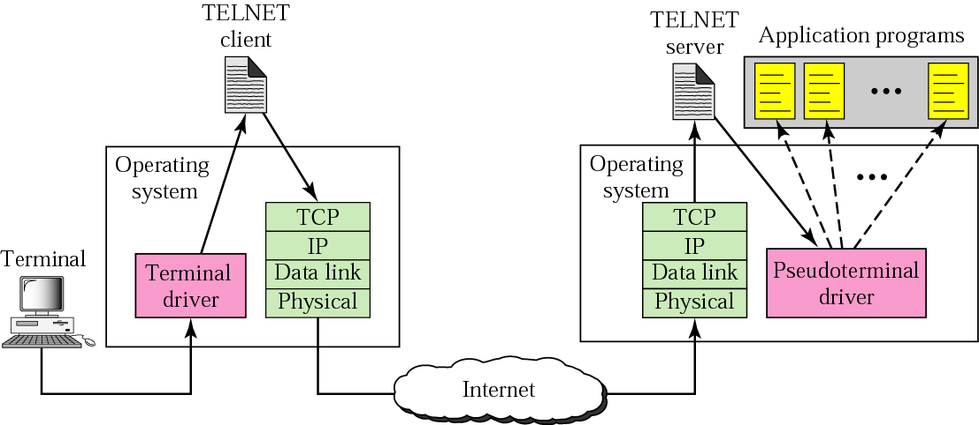
Figure 18.2 Remote login

Slide 7
NETWORK VIRTUAL
TERMINAL (NVT)
Via a universal interface called the Network Virtual Terminal (NVT) character set, the TELNET client translates characters (data or commands) that come from the local terminal into NVT form and delivers them to the network. The TELNET server translates data and commands from NVT form into the form acceptable by the remote computer.

Slide 8
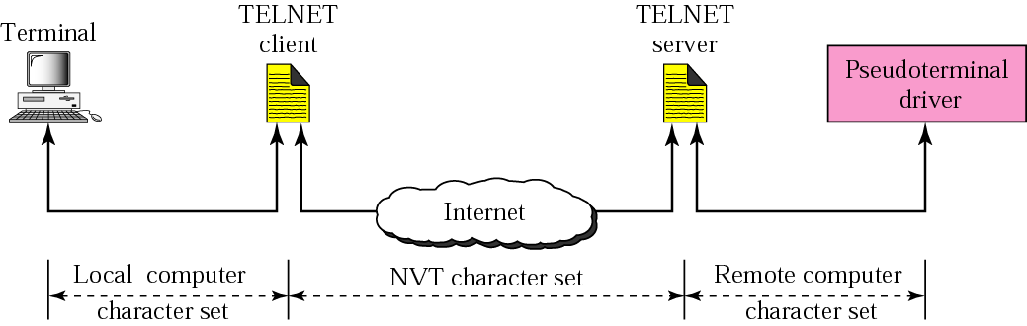
Concept of NVT

Slide 9
NVT CHARACTER SET
NVT uses two sets of characters, one for data and one for control. Both are 8-bit bytes.
The topics discussed in this section include:
Data Characters
Control Characters

Slide 10
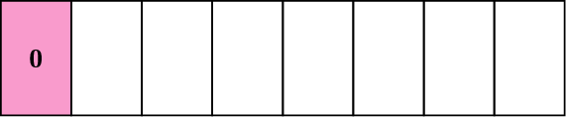
Format of data characters

Slide 11
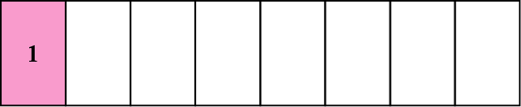
Format of control characters

Slide 12
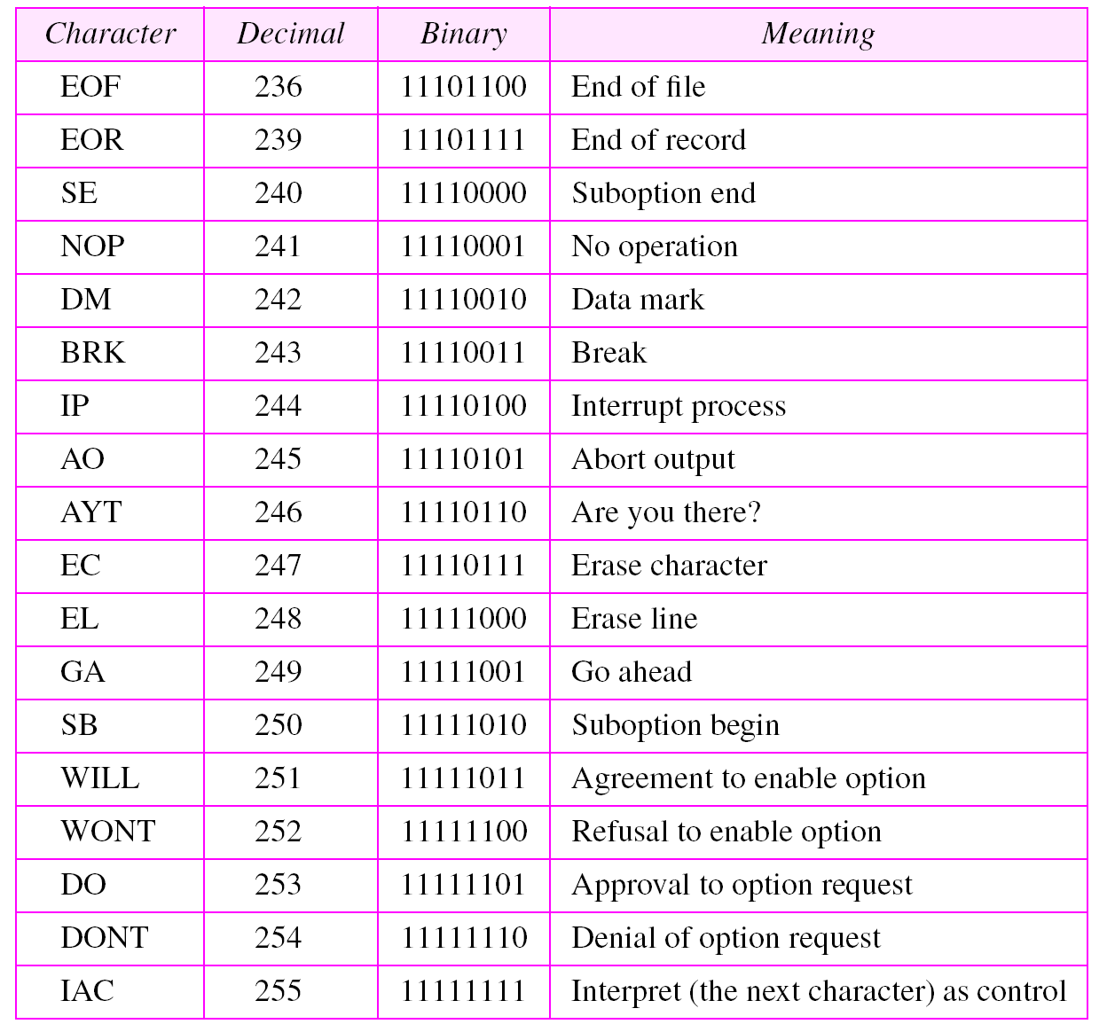
Some NVT control characters

Slide 13
EMBEDDING
The same connection is used by TELNET for sending both data and control characters. TELNET accomplishes this by embedding the control characters in the data stream.

Slide 14
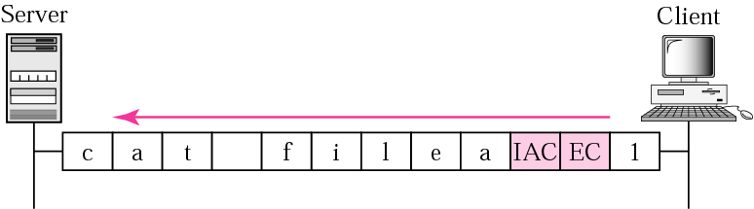
An example of embedding

Slide 15
OPTIONS
TELNET lets the client and server negotiate options before or during the use of the service. Options are extra features available to a user with a more sophisticated terminal.

Slide 16
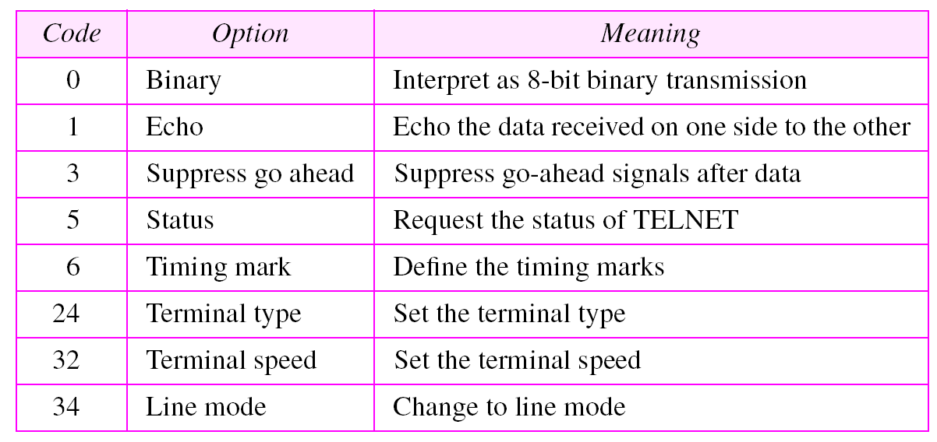
Options

Slide 17
OPTION NEGOTIATION
To use any of the options first requires option negotiation between the client and the server. Four control characters are used for this purpose.
The topics discussed in this section include:
Enabling an Option
Disabling an Option
Symmetry

Slide 18
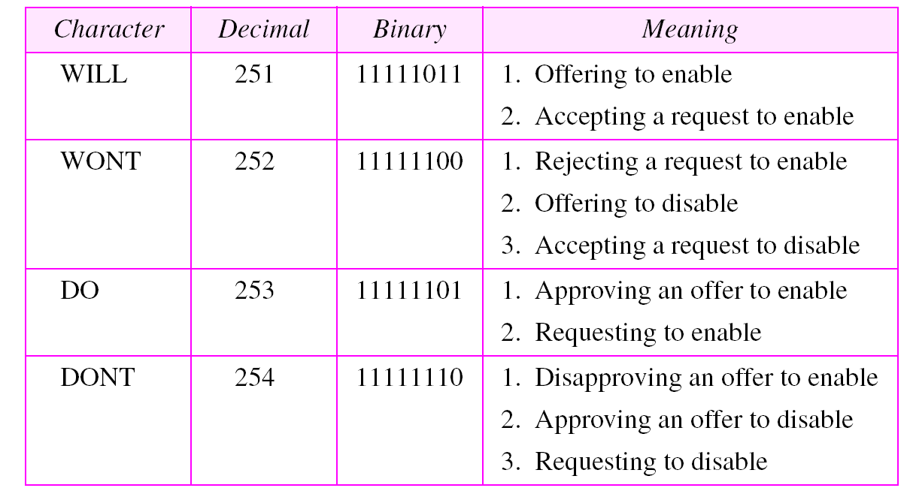
NVT character set for option negotiation

Slide 19
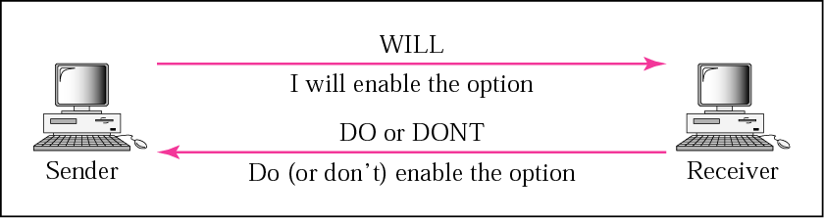
Offer to enable an option

Slide 20
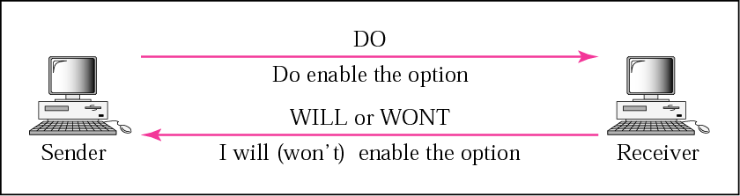
Request to enable an option

Slide 21
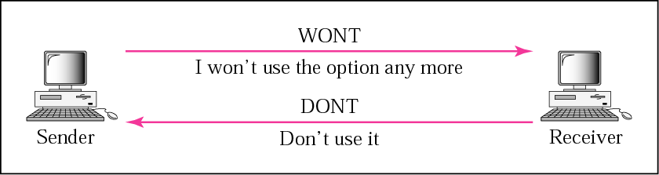
Figure 18.9 Offer to disable an option

Slide 22
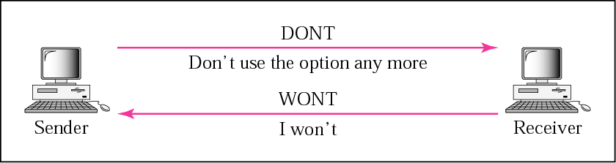
Figure 18.10 Request to disable an option

Slide 23
Example 1
Figure 18.11 shows an example of option negotiation. In this example, the client wants the server to echo each character sent to the server. In other words, when a character is typed at the user keyboard terminal, it goes to the server and is sent back to the screen of the user before being processed. The echo option is enabled by the server because it is the server that sends the characters back to the user terminal. Therefore, the client should request from the server the enabling of the option using DO. The request consists of three characters: IAC, DO, and ECHO. The server accepts the request and enables the option. It informs the client by sending the three character approval: IAC, WILL, and ECHO.
See Next Slide

Slide 24
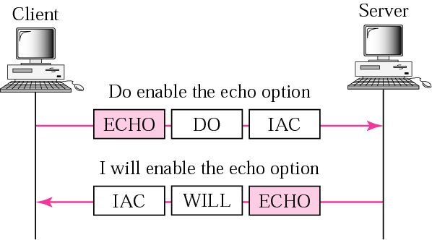
Figure 18.11 Example 1: Echo option

